Slide 1
Microsoft Access -
A Primer for Relational Database Design and Use
Dr. Hatem
2018
PA Harris, Vanderbilt University

Slide 2
Microsoft Access – Module 1
An Overview of MS-Access
PA Harris, Vanderbilt University

Slide 3
What is Microsoft Access?
Microsoft Access is a relational database management system (DBMS or RDBMS). At the very core, it is a software “engine” that provides an interface between physical data and user application queries.
Other examples of DBMS applications include:
Oracle
mySQL
SQL Server (Microsoft)
DB2 (IBM)
Informix
PA Harris, Vanderbilt University

Slide 4
Why choose MS-Access over SPSS / Excel?
Although there is always overlap, the following rules might help when deciding when / when not to use MS Access:
MS Access is best used for long-term data storage and/or data sharing.
MS Excel is best used for minor data collection, manipulation, and especially visualization.
SPSS is best used for minor data collection and especially data analysis.
It is easy to export data from MS Access to Excel → SPSS
PA Harris, Vanderbilt University

Slide 5
Why choose MS-Access over other DBMS systems?
Cheap, readily available (packaged with MS-Office Premium).
Easy to use (relative to other systems –Oracle may require one FTE to maintain the server as a database administrator and another FTE to serve as an application developer).
Includes front-end tools for rapid application development (RAD). This also makes MS-Access a good prototype environment.
PA Harris, Vanderbilt University

Slide 6
Why choose other DBMS systems over MS-Access?
MS-Access can handle a large number of records, but is somewhat slow compared to some of the high-end platforms.
Multiple users may use the database simultaneously, but MS-Access is known to become unstable with greater than 3-5 users.
There is a “snob factor”. I personally recommend the use of other systems (Oracle, SQL Server, mySQL, etc) when writing grant proposals - especially phase II type grants).
PA Harris, Vanderbilt University

Slide 7
What is in an MS-Access file - 1?
Although the term “database” typically refers to a collection of related data tables, an Access database includes more than just data. In addition to tables, you can add:
Saved queries (stored procedures) - organizing and/or manipulating data
Forms – gui interaction with data, event programming
Reports – customized results for printing (~ static forms)
Macros and VB programs for extending functionality
Microsoft provides some logical integration of these tools through “wizards”. However, these are pretty basic - most developers must pick and choose the best approach when implementing applications.
PA Harris, Vanderbilt University

Slide 8
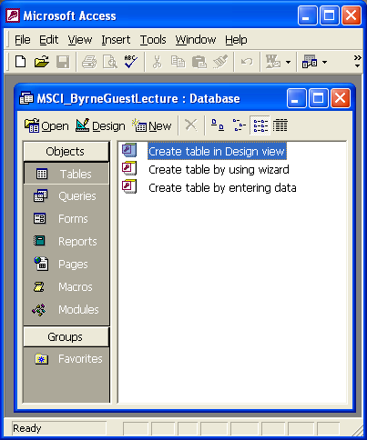
What is in an MS-Access file - 2?
Unless advanced techniques are employed, all entities are stored in one *.mdb file. When running, a locking file (*.ldb) is also visible. Only the mdb file needs to be copied to transfer the database to another computer or location.
Ex.
MSCI_ByrneGuestLecture.mdb
PA Harris, Vanderbilt University

Slide 9
What is in an MS-Access file - 3?
VB + Macros – Event Driven Automation, etc.
Forms (Active)
Reports (Static)
Queries
Tables
Demographics
Ethnicity
Labs
H & P
PA Harris, Vanderbilt University

Slide 10
Advanced – Splitting
Front-End File - Contains all Application Entities (Forms, Queries, etc.) and links to data tables in back-end file. Note you may have more than one FE to accommodate different user types.
VB + Macros – Event Driven Automation, etc.
Forms (Active)
Reports (Static)
Queries
Tables
Demographics
Ethnicity
Labs
H & P
Back-End File - Contains all Data Tables
PA Harris, Vanderbilt University

Slide 11
Microsoft Access – Module 1 Summary
MS-Access is a powerful relational database program. It has many integrated features and can be greatly customized to fit most personal/departmental needs for data collection and storage.
PA Harris, Vanderbilt University

Slide 12
Microsoft Access – Module 2
Creating / Working with Tables
PA Harris, Vanderbilt University

Slide 13
Tables – Glucose Measurement Database
We wish to construct a database to track waking glucose measurements for an indefinite amount of time on 100 patients receiving 3 possible drug combinations.
Why would this be difficult in MS-Excel or SPSS?
PA Harris, Vanderbilt University

Slide 14
Tables Overview
Think of Access as a collection of spreadsheets that are relationally linked.
Demographics
Patient_ID
Fname
Lname
Address
Phone
Gender
Race
DOB
Height
Glucose
Glucose_ID
Patient_ID
Date
Weight
Med_ID
Glucose
Meds
Med_ID
DrugCombonation
STORE DATA ONE TIME / ONE PLACE
DO NOT STORE CALCULATED DATA
PA Harris, Vanderbilt University

Slide 15
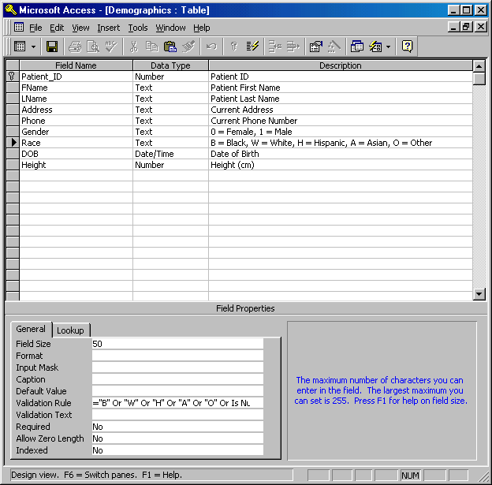
Table Demonstration - Live
General Setup for Tables
Describe General Options
Show Validation Rule
Relationships
Lookup Option
PA Harris, Vanderbilt University

Slide 16
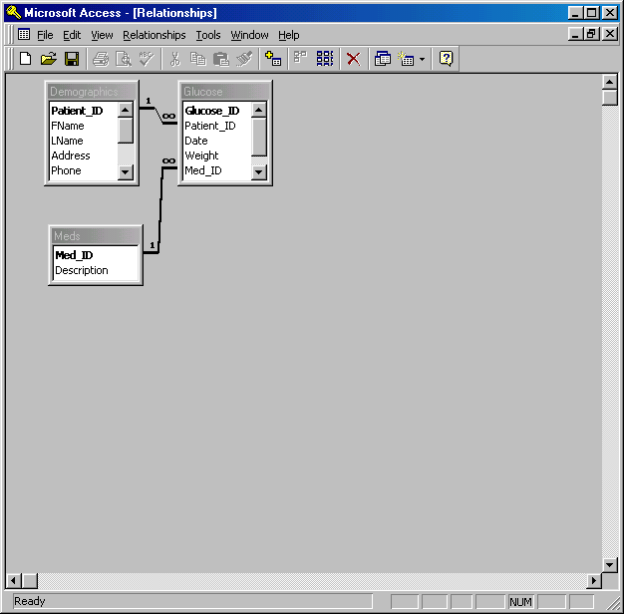
Table Relationships - Live
Table Relationships
Describe Cascade Features
PA Harris, Vanderbilt University

Slide 17
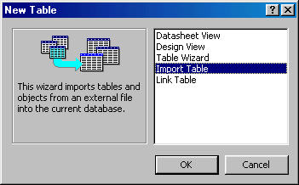
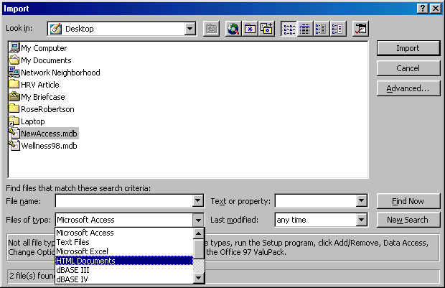
Table Import / Link - Live
Importing a Table makes a copy of existing data
Linking a Table lets you control existing data through Access (Exercise Caution !)
Note that you may import non-Access files.
PA Harris, Vanderbilt University

Slide 18
MS Access – Module 2 Summary
Data storage principles
Attempt to store data 1 time / 1 place;
Do not store data that may be calculated from other fields (utilize queries); and
Strive for very discrete data storage (no ambiguity – garbage in / garbage out).
Choose real or arbitrary (autonumber) unique identifier for each record.
Relationships
Use table relationships to automatically cascade delete and update records.
Other Data Sources
Import = Copy; Link = Live Connect.
PA Harris, Vanderbilt University

Slide 19
Microsoft Access – Module 3
Creating / Working with Queries
PA Harris, Vanderbilt University

Slide 20
Query Overview - 1
An MS-Access query is a set of stored SQL instructions that manipulate and/or select data from one or more tables.
Select Query – Data grouping and/or filtering
Make-Table Query – Select + creates/populates new table.
Update Query – Updates fields from specified table data
Append Query – Runs query on one table, appends results to a table
Delete Query – Delete selected records from table
PA Harris, Vanderbilt University

Slide 21
Query Overview - 2
SQL (Structured Query Language) is a very widely used database language designed specifically for communicating with databases
SQL is not proprietary – almost every DBMS supports SQL (including MS-Access).
SQL is relatively easy to learn, but extremely powerful – one of the easiest ways to learn is to use MS-Access Query by Example methods, then look at the generated SQL command
Remember that a query is nothing more than the database engine running the stored SQL command (it looks and sometimes acts like a table, but really adds little mass to the database file)
PA Harris, Vanderbilt University

Slide 22
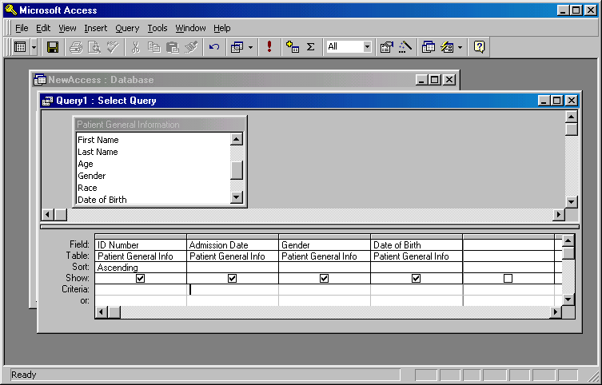
One Table Query Example - Live
Use this button to toggle between design, sheet and SQL views.
Right-Click + Add to add table(s)
Custom sort by one or more fields.
Drag and Drop Fields
PA Harris, Vanderbilt University

Slide 23
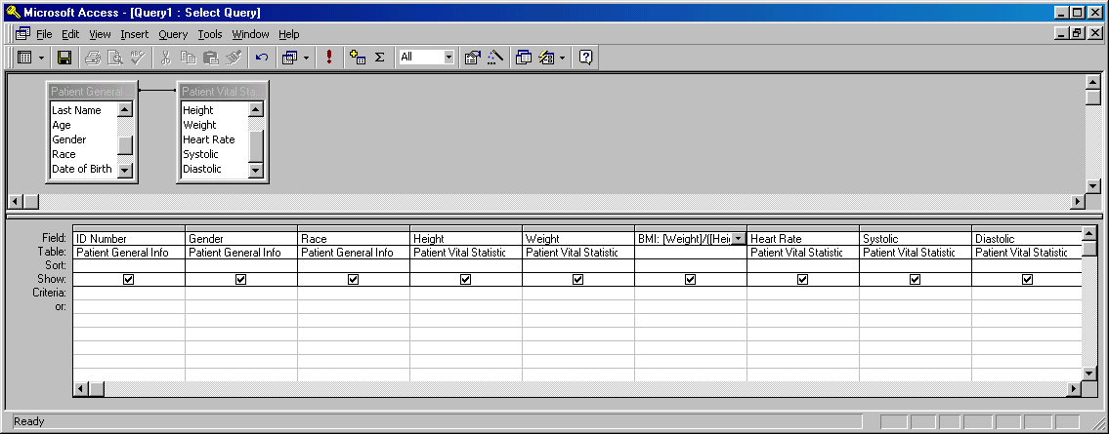
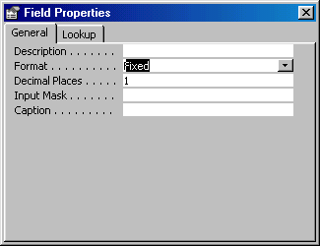
2-Table Query Example - Live
Right-Click + Add to add table(s)
Note that relationship often automatic.
Calculated Field
Drag and Drop Fields
BMI: [Weight]/([Height]/100)^2
Right-Clicking gray area above field enables property changes.
PA Harris, Vanderbilt University

Slide 24
Query – Calculating Fields
Name the calculated field, then type a colon, then type the equation using brackets ( [ ] ) around table fields. If there is ambiguity in the field names between tables, you may need to type table.[field] format.
Ex: BMI: [Weight]/([Height]/100)^2
PA Harris, Vanderbilt University

Slide 25
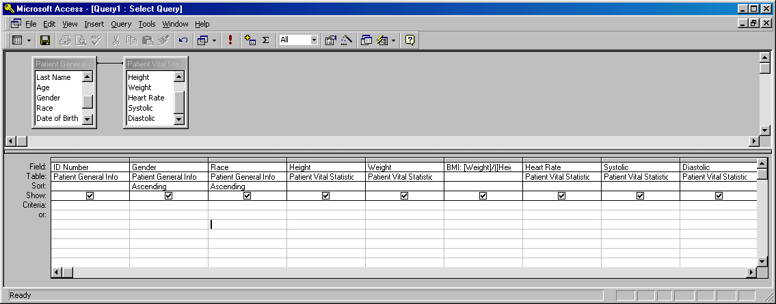
Query – Sorting Data
Choose Ascending or Descending in the Sort Row
This query would sort by Gender THEN by Race.
PA Harris, Vanderbilt University

Slide 26

Query – Filtering Data
You need not “show” the data field to use as a filter.
This query will return all records in the database for:
Females
who are not white
whose height are greater than 150 cm
and who weigh between 60 and 70 kg
PA Harris, Vanderbilt University

Slide 27
Query – Filter Operators
= equals
> greater than
>= greater than or equal
< less than
<= less than or equal
<> not equal to
Between between two values
Is Null field is empty
is not null field is not empty
Like Matches a pattern (Like John*)
OR Logical OR (one or other is true)
AND Logical AND (both are true)
etc.
PA Harris, Vanderbilt University

Slide 28
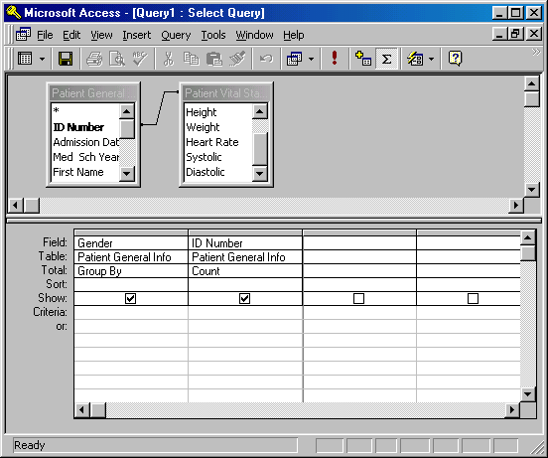
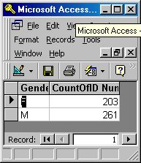
Query – Grouping Data - 1
Clicking the Totals Button Enables Grouping, Counting and Statistical Options
Running this Query indicates there are 203 Females and 261 Males in the database.
Notice new “Total” row.
Each field (column) can be set.
PA Harris, Vanderbilt University

Slide 29
Query – Grouping Data -2
Totals Options Include:
Group By
Sum
Avg
Min
Max
Count
StDev
Var
PA Harris, Vanderbilt University

Slide 30
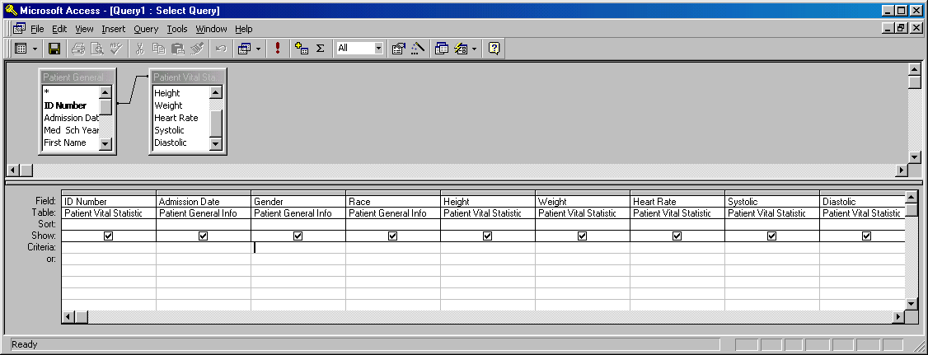
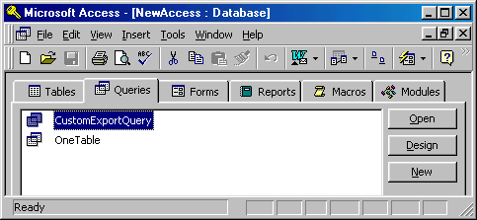
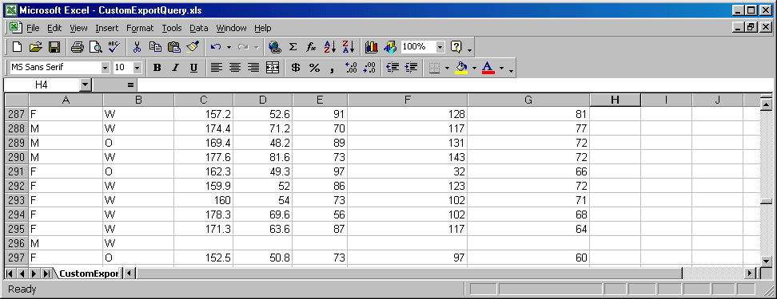
Query – Export Data
Create and Save Query
1)
Use OfficeLinks (Excel Toggle Option) to “Analyze it with Excel”
2)
Data Automatically Exported to Excel
3)
PA Harris, Vanderbilt University

Slide 31
MS Access – Module 3 Summary
Queries are extremely easy to set up/use and provide an up-to-date snapshot of your data at any time.
Queries may be used to calculate values based upon existing fields, join fields from separate tables, globally update or delete data, and export linked/calculated data to external programs.
Under the hood, queries are really nothing more than stored SQL statements that are run upon command. They add little mass to the file application.
If you use MS-Access for nothing else, you should learn to import data and become proficient with query functionality.
PA Harris, Vanderbilt University

Slide 32
MS-Access Import/Query Practice
Import data from the sample Excel file “msci_data.xls” into an Access database table. Design and save a new query named to display only the following fields: 1) Case; 2) Sex; 3) BMI_Av (a calculated field computed by averaging BMI_1 and BMI_2). Select filter criteria in the query to show only those records where: 1) age is between 30 and 90; 2) the sex field equals 0; and 3) and the survdays field contains a value between 100 and 300.
Using the imported table from part A, design and save a new query named Question2 to provide summary data for each sex / alive combination (ie we want to see 4 rows of data). For each of these combinations compute: 1) count of case numbers; 2) average of length of stay (LOS); and 3) standard deviation of length of stay (LOS).

Slide 33
Microsoft Access – Module 4
Creating / Working with Forms/Reports
PA Harris, Vanderbilt University

Slide 34
Graphical User Interface (GUI)
Although it is possible to enter data directly into a table, you can enhance data quality by forcing data entry through forms.
Depending upon your users, you may wish to set things up so they never even see the database window. In other words, you can design your application so they only touch the data through programmed forms.
PA Harris, Vanderbilt University

Slide 35
Graphical User Interface (GUI)
Continuing with the glucose database we formulated earlier, we’ll now attempt to build a graphical user interface to:
Collect Data
Periodically report data through pre-formatted reports
Quit the program
PA Harris, Vanderbilt University

Slide 36
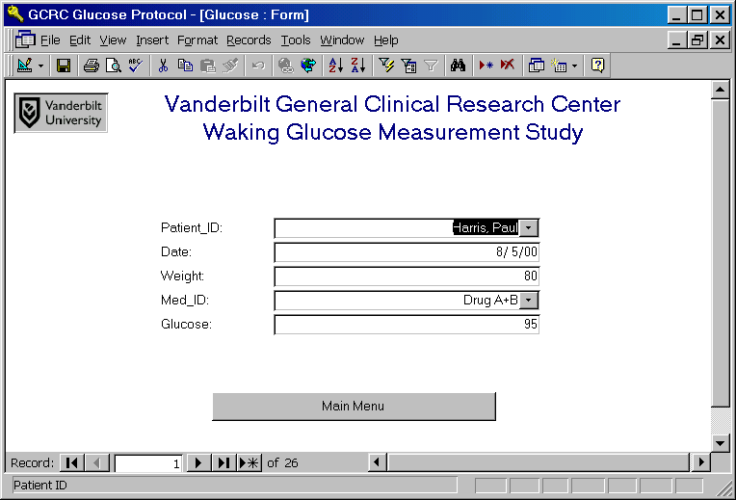
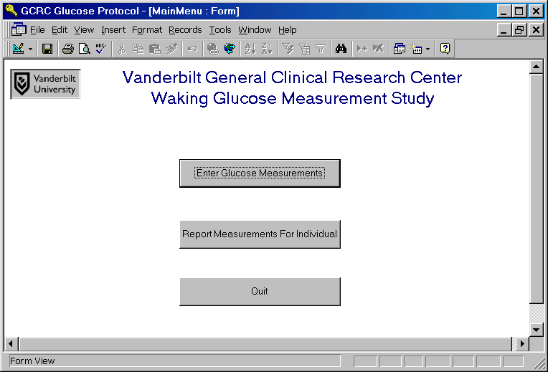
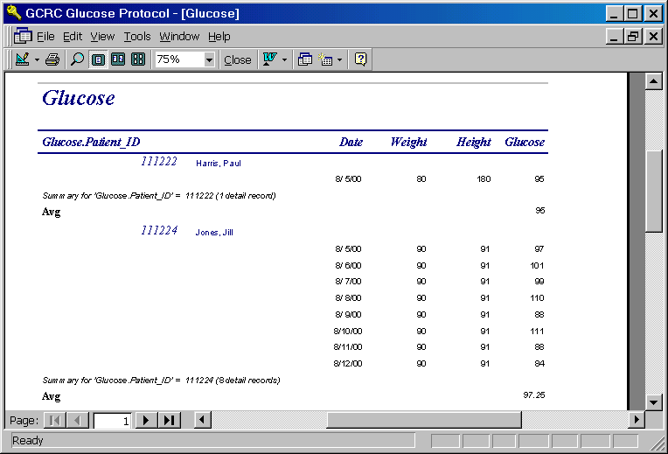
GUI – Forms/Report Live
Out of Program
PA Harris, Vanderbilt University

Slide 37
MS Access – Module 4 Summary
Use forms and reports together to build a data software application.
Design to the lowest common denominator (Murphy will use your program early and often)
Always look for and design carrots to win over the true data entry personnel. If it saves them time or offers something they couldn’t do before, they might use the application.
Look for champions – bright, energetic individuals who will try something new, etc.
PA Harris, Vanderbilt University

Slide 38
MS Access – Resources
I cannot recommend the BEST MS-Access book. However, I can recommend the following series of books that I usually turn to when learning new technology:
Visual Quickstart Series – beginner/intermediate level
O’Reilly Series – intermediate/advanced level
There is also an excellent tutorial on the web:
http://mis.bus.sfu.ca/tutorials/MSAccess/tutorials.html
PA Harris, Vanderbilt University

